Slide 1
After DS & ML Course
Get subscription of these blogs:
➢ www.medium.com
➢ www.towardsdatascience.com
➢ www.machinelearningmastery.com
➢ www.analyticsvidhya.com
➢ www.kaggle.com
➢ www.fivethirtyeight.com

Slide 2


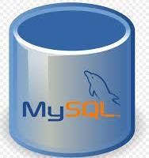



After DS & ML Course
Programing
Math
Deep Learning
Datacamp Kaggle GitHub
Andrew Ng Course https://www.coursera. org/specializations/dee p-learning
Udacity DLND https://www.udacity.com/c ourse/deep-learning- nanodegree--nd101
Linear Algebra
Essence of Linear Algebra https://youtu.be/fNk_zzaMoSs
MIT 18.06
https://youtu.be/7UJ4CFRGd-U
Statistics
Duke University – Coursera https://www.coursera.org/specializa tions/statistics
Calculus
Datacamp Hackerrank
Kaggle GitHub

